Slide 1
Apache Pig
徐培成

Slide 2
Pig简介
Pig提供了一个基于Hadoop的并行地执行数据流处理的引擎。
它包含了一个脚本语言，称为Pig Latin，用来描述这些数据流。Pig Latin本身提供了许多传统的数据操作（如 join、sort、filter等），同时允许用户自己开发一些自定义函数用来读取、处理和写数据。

Slide 3
Pig简介
数据处理由多个MapReduce实现
Pig提供更多数据结构，支持嵌套和多值
Pig提供了变换操作，甚至join

Slide 4
Pig组成
Pig Latin-数据流语言
Pig执行环境 单JVM的local环境 集群环境

Slide 5
Pig执行
脚本语言
每次变换与操作转变成MapReduce作业
节省MR的繁琐
支持UDF，易于重用

Slide 6
Pig使用场景
擅长批处理
不擅长小数据量操作，因为要扫面整个数据集
支持UDF，易于重用

Slide 7
Pig安装
下载
pig-0.15.0.tar.gz
安装 tar -xzvf pig-0.15.0.tar.gz
环境变量 PIG_INSTALL=/usr/soft/pig-0.15.0 PATH=$PATH:/usr/soft/pig-0.15.0/bin

Slide 8
Pig执行模式
local
运行单个JVM
使用本地文件系统
用于测试和小型数据
$>pig -x local $grunt> //grunt是pig的shell

Slide 9
Pig执行模式
MapReduce
将操作翻译成MR job，在hadoop上执行
检查版本兼容性
配置conf/pig.properties fs.default.name=hdfs://s0:8021/ mapred.job.tracker=s0:8021
启动 $pig //默认就是mr模式

Slide 10
Pig运行
Grant shell
调用脚本 $>pig xxx.sh //
java编程使用Pig 同jdbc

Slide 11
Pig体验
命令 $>pig //进入shell $grunt>rec = LOAD 'URL' //加载文件 as (x:chararry,y:int,...); //as可省略,tab分割 $grunt>DUMP rec; //输出records集合 (1950,0,1) (1950,22,1) $grunt>DESCRIBE rec; //输出元组信息 records: {year: chararray,temperature: int,quality: int}

Slide 12
Pig体验
命令 $grunt>rec2=FILTER rec BY x!=n AND x in (a,b,c); //按照范围过滤 $grunt>rec3=GROUP rec2 BY temp //分组集合 (1949,{(1949,78,1),(1949,111,1)}) (1950,{(1950,-11,1),(1950,22,1),(1950,0,1)})

Slide 13
Pig体验
命令 $grunt>DESCRIBE rec3 //描述分组集合 grouped_records: {group: chararray,filtered_records: {year: chararray,temperature: int,quality: int}} //foreach:循环集合 //generate:生成新元组,后面是字段列表 //max:取出最大值 $grunt>max_temp = FOREACH grouped_records GENERATE group,MAX(filtered_records.temperature);

Slide 14
Pig体验
命令 $grunt>ILLUSTRATE max_temp;//阐述集合，中间过程

Slide 15
Grunt Shell
启动
本地模式
./pig -x local
MapReduce模式
./pig -x mapreduce
执行
grunt> customers = LOAD 'customers.txt' USING PigStorage(',');
退出
‘ctrl + d’

Slide 16
Grunt Shell
在Grunt中执行shell命令
grunt> sh shell command parameters
例如：
grunt> sh ls // 列出/pig/bin/目录下的文件
pig
pig_1444799121955.log
pig.cmd
pig.py

Slide 17
Grunt Shell
在Grunt中执行HDFS命令
grunt> fs File System command parameters
例如：
grunt> fs –ls // 列出hdfs根目录的文件

Slide 18
Grunt Shell
实用命令
clear // 清屏
help // 帮助
history // 历史执行记录
quit // 退出Grunt
set // 可以设置 default_parallel、debug、 job.name、job.priority、stream.skippath
kill // grunt> kill JobId，终止指定Jobid的 MapReduce任务。

Slide 19
Grunt Shell
实用命令
exec // 在Grunt shell中执行Pig script
grunt> exec [–param param_name = param_value] [–param_file file_name] [script]
例如：
/pig_data/sample_script.pig //脚本内容见备注
grunt> exec /sample_script.pig
Notes:
Student.txt 内容：
001,Rajiv,Hyderabad
002,siddarth,Kolkata
003,Rajesh,Delhi
sample_script.pig内容：
student = LOAD 'hdfs://localhost:9000/pig_data/student.txt' USING PigStorage(', ') as (id:int,name:chararray,city:chararray);
Dump student;
grunt> exec /sample_script.pig
grunt> Dump;
(1,Rajiv,Hyderabad)
(2,siddarth,Kolkata)
(3,Rajesh,Delhi)

Slide 20
Grunt Shell
实用命令
run // 在Grunt shell中执行Pig script
grunt> run [–param param_name = param_value] [–param_file file_name] [script]
例如：
/pig_data/sample_script.pig //脚本内容见备注
grunt> run /sample_script.pig
exec&run区别：
使用run运行的语句，可以通过history查看到
Notes:
Student.txt 内容：
001,Rajiv,Hyderabad
002,siddarth,Kolkata
003,Rajesh,Delhi
sample_script.pig内容：
student = LOAD 'hdfs://localhost:9000/pig_data/student.txt' USING PigStorage(', ') as (id:int,name:chararray,city:chararray);
Dump student;
grunt> run /sample_script.pig
grunt> Dump;
(1,Rajiv,Hyderabad)
(2,siddarth,Kolkata)
(3,Rajesh,Delhi)

Slide 21
Pig Latin简介
Pig Latin是一种数据流语言，每个处理步骤都会产生一个新的数据集，或者产生一个新的关系。
在input = load ‘data’这句脚本中，input是加载数据集data后结果的关系名称（也就是我们通常说的别名）。
关系名称看起来和变量的概念相似，但是它们不是变量。关系名称是可以被重用的。

Slide 22
Pig Latin语法
命令
;号结尾 //有些可以不加
ls / //列出hdfs文件系统
-- //注释
/**/ //多行注释
DUMP //指令才触发程序执行
LOAD/STORD //输入和存储

Slide 23
Pig Latin脚本执行
脚本（Sample_script.pig ）
student = LOAD 'hdfs://localhost:9000/pig_data/student.txt' USING PigStorage(',') as (id:int,name:chararray,city:chararray); Dump student;
执行
本地模式： $ pig -x local Sample_script.pig
mapreduce模式： pig -x mapreduce Sample_script.pig

Slide 24
Pig Latin基本数据类型
基本数据类型
int/long/float/double/chararray/Bytearray/Boolean/Datetime/Biginteger/Bigdecimal

Slide 25
Pig Latin复杂类型
复杂数据类型
Tuple //例如： (raja, 30)
Bag //例如： {(raju,30),(Mohhammad,45)}
Map //例如： [ ‘name’#’Raju’, ‘age’#30]
NULL值：
Pig中有数据元素为null的概念。任何数据类型的数据都可以为null。Pig中null的概念与SQL中所说的null的概念是一样的，而与C、java、Python等语言中null 的概念完全不同。
在Pig中null值表示这个值是未知的。这可能是因为数据缺失，或者在处理数据时发生了错误等原因造成的。

Slide 26
Pig Latin 数据模型-模式
load时指定数据类型
load时不指定数据类型，pig就认为是chararray
数据类型转换：
（int）long

Slide 27
Pig Latin运算符
运算符
+、-、*、/、%、? : 、CASE WHEN THEN ELSE END
==、!=、>、<、>=、<=、matches
()、{}、[]
示例详见备注
Notes:
例如：
CASE f2 % 2
WHEN 0 THEN 'even'
WHEN 1 THEN 'odd'
END
f1 matches '.*tutorial.*'
(Raju, 30)
{(Raju, 30), (Mohammad, 45)}
[name#Raja, age#30]

Slide 28
Pig Latin关系运算
关系运算
Loading&Storing:LOAD/STORE
Filtering: FILTER/DISTINCT/
FOREACH… GENERATE:/STREAM
Grouping/Joining:JOIN/COGROUP/GROUP/CROSS
Sorting:ORDER/LIMIT
Combining&Splitting:UNION/SPLIT
Diagnostic:DUMP/DESCRIBE/EXPLAIN/ILLUSTRATE

Slide 29
Load&Store
Load
Relation_name = LOAD 'Input file path' USING function as schema;
function：BinStorage, JsonLoader, PigStorage, TextLoader,或用户自定义
例：
grunt> student = LOAD 'hdfs://localhost:9000/pig_data/student_data.txt' USING PigStorage(',')as ( id:int, firstname:chararray, lastname:chararray, phone:chararray, city:chararray );
Notes:
student_data.txt
001,Rajiv,Reddy,9848022337,Hyderabad
002,siddarth,Battacharya,9848022338,Kolkata
003,Rajesh,Khanna,9848022339,Delhi
004,Preethi,Agarwal,9848022330,Pune
005,Trupthi,Mohanthy,9848022336,Bhuwaneshwar
006,Archana,Mishra,9848022335,Chennai.

Slide 30
Load&Store
Store
STORE Relation_name INTO ' required_directory_path ' [USING function];
例如：
grunt> STORE student INTO ' hdfs://localhost:9000/pig_Output/ ' USING PigStorage (',');

Slide 31
Diagnostic
检验load执行的结果
Dump Relation_name //显示运行结果
Describe Relation_name //查看schema
Explain Relation_name // logical, physical, and MapReduce
Illustrate Relation_name //一步一步地执行语句
例：
Dump student
Describe student

Slide 32
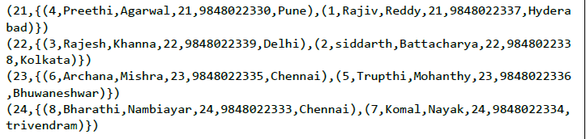
Pig Group
对一列分组
Group_data = GROUP Relation_name BY age;
例：
grunt> group_data = GROUP student_details by age;
Dump group_data;
Describe group_data;
Illustrate group_data;
Notes:
student_details.txt
001,Rajiv,Reddy,21,9848022337,Hyderabad
002,siddarth,Battacharya,22,9848022338,Kolkata
003,Rajesh,Khanna,22,9848022339,Delhi
004,Preethi,Agarwal,21,9848022330,Pune
005,Trupthi,Mohanthy,23,9848022336,Bhuwaneshwar
006,Archana,Mishra,23,9848022335,Chennai
007,Komal,Nayak,24,9848022334,trivendram
008,Bharathi,Nambiayar,24,9848022333,Chennai
student_details = LOAD 'hdfs://localhost:9000/pig_data/student_details.txt' USING PigStorage(',')as (id:int, firstname:chararray, lastname:chararray, age:int, phone:chararray, city:chararray);
grunt> group_data = GROUP student_details by age;
Dump group_data;
Output
(21,{(4,Preethi,Agarwal,21,9848022330,Pune),(1,Rajiv,Reddy,21,9848022337,Hyderabad)}) (22,{(3,Rajesh,Khanna,22,9848022339,Delhi),(2,siddarth,Battacharya,22,9848022338,Kolkata)}) (23,{(6,Archana,Mishra,23,9848022335,Chennai),(5,Trupthi,Mohanthy,23,9848022336,Bhuwaneshwar)}) (24,{(8,Bharathi,Nambiayar,24,9848022333,Chennai),(7,Komal,Nayak,24,9848022334,trivendram)})
grunt> Describe group_data;
group_data: {group: int,student_details: {(id: int,firstname: chararray,lastname: chararray,age: int,phone: chararray,city: chararray)}}

Slide 33
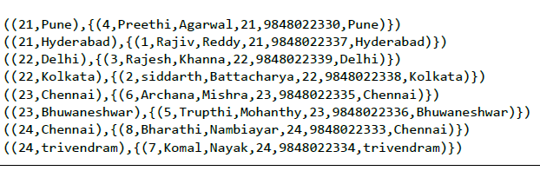
Pig Group
对多列分组
grunt> group_multiple = GROUP student_details by (age, city);
例如：
grunt> group_multiple = GROUP student_details by (age, city);
Notes:
grunt> group_multiple = GROUP student_details by (age, city);
grunt> Dump group_multiple;
((21,Pune),{(4,Preethi,Agarwal,21,9848022330,Pune)}) ((21,Hyderabad),{(1,Rajiv,Reddy,21,9848022337,Hyderabad)}) ((22,Delhi),{(3,Rajesh,Khanna,22,9848022339,Delhi)}) ((22,Kolkata),{(2,siddarth,Battacharya,22,9848022338,Kolkata)}) ((23,Chennai),{(6,Archana,Mishra,23,9848022335,Chennai)}) ((23,Bhuwaneshwar),{(5,Trupthi,Mohanthy,23,9848022336,Bhuwaneshwar)}) ((24,Chennai),{(8,Bharathi,Nambiayar,24,9848022333,Chennai)}) ((24,trivendram),{(7,Komal,Nayak,24,9848022334,trivendram)})

Slide 34
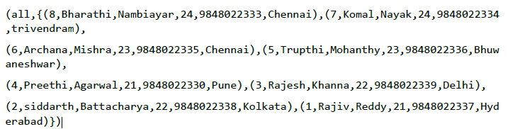
Pig Group
对所有列分组
grunt> group_all = GROUP student_details All;
Dump group_all;
Notes:
grunt> group_all = GROUP student_details All;
grunt> Dump group_all;
(all,{(8,Bharathi,Nambiayar,24,9848022333,Chennai),(7,Komal,Nayak,24,9848022334,trivendram),
(6,Archana,Mishra,23,9848022335,Chennai),(5,Trupthi,Mohanthy,23,9848022336,Bhuwaneshwar),
(4,Preethi,Agarwal,21,9848022330,Pune),(3,Rajesh,Khanna,22,9848022339,Delhi),
(2,siddarth,Battacharya,22,9848022338,Kolkata),(1,Rajiv,Reddy,21,9848022337,Hyderabad)})

Slide 35
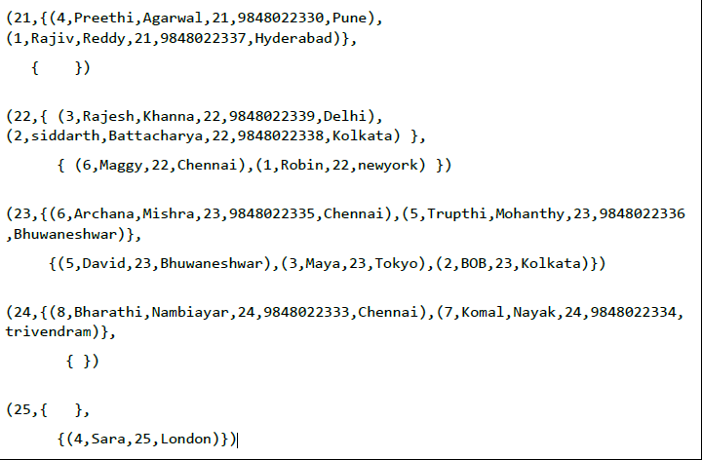
Pig Cogroup
Cogroup用于多个关系的分组
grunt> cogroup_data = COGROUP student_details by age, employee_details by age;
Dump cogroup_data;
Notes:
student_details.txt
001,Rajiv,Reddy,21,9848022337,Hyderabad
002,siddarth,Battacharya,22,9848022338,Kolkata
003,Rajesh,Khanna,22,9848022339,Delhi
004,Preethi,Agarwal,21,9848022330,Pune
005,Trupthi,Mohanthy,23,9848022336,Bhuwaneshwar
006,Archana,Mishra,23,9848022335,Chennai
007,Komal,Nayak,24,9848022334,trivendram
008,Bharathi,Nambiayar,24,9848022333,Chennai
employee_details.txt
001,Robin,22,newyork
002,BOB,23,Kolkata
003,Maya,23,Tokyo
004,Sara,25,London
005,David,23,Bhuwaneshwar
006,Maggy,22,Chennai
student_details = LOAD 'hdfs://localhost:9000/pig_data/student_details.txt' USING PigStorage(',')as (id:int, firstname:chararray, lastname:chararray, age:int, phone:chararray, city:chararray);
employee_details = LOAD 'hdfs://localhost:9000/pig_data/employee_details.txt' USING PigStorage(',')as (id:int, name:chararray, age:int, city:chararray);
grunt> cogroup_data = COGROUP student_details by age, employee_details by age;
Dump cogroup_data;
(21,{(4,Preethi,Agarwal,21,9848022330,Pune), (1,Rajiv,Reddy,21,9848022337,Hyderabad)},
{ })
(22,{ (3,Rajesh,Khanna,22,9848022339,Delhi), (2,siddarth,Battacharya,22,9848022338,Kolkata) },
{ (6,Maggy,22,Chennai),(1,Robin,22,newyork) })
(23,{(6,Archana,Mishra,23,9848022335,Chennai),(5,Trupthi,Mohanthy,23,9848022336,Bhuwaneshwar)},
{(5,David,23,Bhuwaneshwar),(3,Maya,23,Tokyo),(2,BOB,23,Kolkata)})
(24,{(8,Bharathi,Nambiayar,24,9848022333,Chennai),(7,Komal,Nayak,24,9848022334,trivendram)},
{ })
(25,{ },
{(4,Sara,25,London)})

Slide 36
Pig Join
Join $>A = LOAD 'A' $>B = LOAD 'B' $>C = JOIN A by $0,B BY $1 $>DUMP C //连接集合 $>STORE C INTO 'xxx.xx' //存储集合

Slide 37
Pig Join
Self-join
Inner-join
Outer-join : left join, right join, and full join

Slide 38
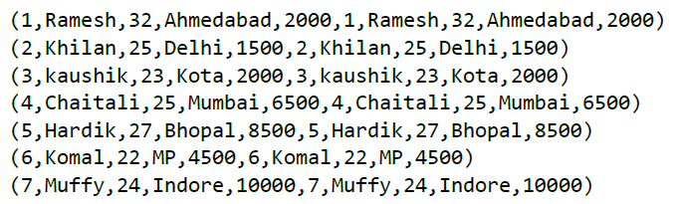
Self Join
表连接自己的表，通常用不同的定义，load多次相同的数据
Relation3_name = JOIN Relation1_name BY key, Relation2_name BY key ;
例如备注中customers1和customers2
grunt> customers3 = JOIN customers1 BY id, customers2 BY id;
Dump customers3;
Notes:
customers.txt
1,Ramesh,32,Ahmedabad,2000.00
2,Khilan,25,Delhi,1500.00
3,kaushik,23,Kota,2000.00
4,Chaitali,25,Mumbai,6500.00
5,Hardik,27,Bhopal,8500.00
6,Komal,22,MP,4500.00
7,Muffy,24,Indore,10000.00
customers1 = LOAD 'hdfs://localhost:9000/pig_data/customers.txt' USING PigStorage(',')as (id:int, name:chararray, age:int, address:chararray, salary:int);
customers2 = LOAD 'hdfs://localhost:9000/pig_data/customers.txt' USING PigStorage(',')as (id:int, name:chararray, age:int, address:chararray, salary:int);
grunt> customers3 = JOIN customers1 BY id, customers2 BY id;
Dump customers3;
Output
(1,Ramesh,32,Ahmedabad,2000,1,Ramesh,32,Ahmedabad,2000)
(2,Khilan,25,Delhi,1500,2,Khilan,25,Delhi,1500)
(3,kaushik,23,Kota,2000,3,kaushik,23,Kota,2000)
(4,Chaitali,25,Mumbai,6500,4,Chaitali,25,Mumbai,6500)
(5,Hardik,27,Bhopal,8500,5,Hardik,27,Bhopal,8500)
(6,Komal,22,MP,4500,6,Komal,22,MP,4500)
(7,Muffy,24,Indore,10000,7,Muffy,24,Indore,10000)

Slide 39

Inner Join
也称为equijoin,返回两个表中连接值相等行
Relation3_name = JOIN Relation1_name BY key, Relation2_name BY key ;
例：
grunt> coustomer_orders = JOIN customers BY id, orders BY customer_id;
Dump coustomer_orders;
Notes:
customers.txt
1,Ramesh,32,Ahmedabad,2000.00
2,Khilan,25,Delhi,1500.00
3,kaushik,23,Kota,2000.00
4,Chaitali,25,Mumbai,6500.00
5,Hardik,27,Bhopal,8500.00
6,Komal,22,MP,4500.00
7,Muffy,24,Indore,10000.00
orders.txt
102,2009-10-08 00:00:00,3,3000
100,2009-10-08 00:00:00,3,1500
101,2009-11-20 00:00:00,2,1560
103,2008-05-20 00:00:00,4,2060
customers = LOAD 'hdfs://localhost:9000/pig_data/customers.txt' USING PigStorage(',')as (id:int, name:chararray, age:int, address:chararray, salary:int);
orders = LOAD 'hdfs://localhost:9000/pig_data/orders.txt' USING PigStorage(',')as (oid:int, date:chararray, customer_id:int, amount:int);
grunt> coustomer_orders = JOIN customers BY id, orders BY customer_id;
Dump coustomer_orders;
Output
(2,Khilan,25,Delhi,1500,101,2009-11-20 00:00:00,2,1560)
(3,kaushik,23,Kota,2000,100,2009-10-08 00:00:00,3,1500)
(3,kaushik,23,Kota,2000,102,2009-10-08 00:00:00,3,3000)
(4,Chaitali,25,Mumbai,6500,103,2008-05-20 00:00:00,4,2060)

Slide 40
Outer Join
不同于Inner Join，Outer Join返回至少一个关系中的所有行，有三种类型：
Left outer join //左表的所有行
Right outer join //右表的所有行
Full outer join //左右表中所有行
Notes:
customers.txt
1,Ramesh,32,Ahmedabad,2000.00
2,Khilan,25,Delhi,1500.00
3,kaushik,23,Kota,2000.00
4,Chaitali,25,Mumbai,6500.00
5,Hardik,27,Bhopal,8500.00
6,Komal,22,MP,4500.00
7,Muffy,24,Indore,10000.00
orders.txt
102,2009-10-08 00:00:00,3,3000
100,2009-10-08 00:00:00,3,1500
101,2009-11-20 00:00:00,2,1560
103,2008-05-20 00:00:00,4,2060
customers = LOAD 'hdfs://localhost:9000/pig_data/customers.txt' USING PigStorage(',')as (id:int, name:chararray, age:int, address:chararray, salary:int);
orders = LOAD 'hdfs://localhost:9000/pig_data/orders.txt' USING PigStorage(',')as (oid:int, date:chararray, customer_id:int, amount:int);
例如：
grunt> outer_left = JOIN customers BY id LEFT OUTER, orders BY customer_id;
Dump outer_left;
grunt> outer_right = JOIN customers BY id RIGHT, orders BY customer_id;
grunt> Dump outer_right;
grunt> outer_full = JOIN customers BY id FULL OUTER, orders BY customer_id;
grunt> Dump outer_full;

Slide 41
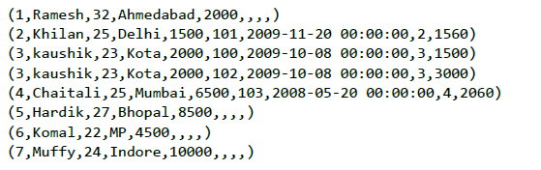
Outer Join
Left outer join 左表所有行
Relation3_name = JOIN Relation1_name BY id LEFT OUTER, Relation2_name BY customer_id;
Notes:
customers.txt
1,Ramesh,32,Ahmedabad,2000.00
2,Khilan,25,Delhi,1500.00
3,kaushik,23,Kota,2000.00
4,Chaitali,25,Mumbai,6500.00
5,Hardik,27,Bhopal,8500.00
6,Komal,22,MP,4500.00
7,Muffy,24,Indore,10000.00
orders.txt
102,2009-10-08 00:00:00,3,3000
100,2009-10-08 00:00:00,3,1500
101,2009-11-20 00:00:00,2,1560
103,2008-05-20 00:00:00,4,2060
customers = LOAD 'hdfs://localhost:9000/pig_data/customers.txt' USING PigStorage(',')as (id:int, name:chararray, age:int, address:chararray, salary:int);
orders = LOAD 'hdfs://localhost:9000/pig_data/orders.txt' USING PigStorage(',')as (oid:int, date:chararray, customer_id:int, amount:int);
例如：
grunt> outer_left = JOIN customers BY id LEFT OUTER, orders BY customer_id;
Dump outer_left;
grunt> outer_right = JOIN customers BY id RIGHT, orders BY customer_id;
grunt> Dump outer_right;
grunt> outer_full = JOIN customers BY id FULL OUTER, orders BY customer_id;
grunt> Dump outer_full;

Slide 42

Outer Join
Right outer 右表所有行
grunt> outer_right = JOIN customers BY id RIGHT, orders BY customer_id;
Notes:
customers.txt
1,Ramesh,32,Ahmedabad,2000.00
2,Khilan,25,Delhi,1500.00
3,kaushik,23,Kota,2000.00
4,Chaitali,25,Mumbai,6500.00
5,Hardik,27,Bhopal,8500.00
6,Komal,22,MP,4500.00
7,Muffy,24,Indore,10000.00
orders.txt
102,2009-10-08 00:00:00,3,3000
100,2009-10-08 00:00:00,3,1500
101,2009-11-20 00:00:00,2,1560
103,2008-05-20 00:00:00,4,2060
customers = LOAD 'hdfs://localhost:9000/pig_data/customers.txt' USING PigStorage(',')as (id:int, name:chararray, age:int, address:chararray, salary:int);
orders = LOAD 'hdfs://localhost:9000/pig_data/orders.txt' USING PigStorage(',')as (oid:int, date:chararray, customer_id:int, amount:int);
例如：
grunt> outer_left = JOIN customers BY id LEFT OUTER, orders BY customer_id;
Dump outer_left;
grunt> outer_right = JOIN customers BY id RIGHT, orders BY customer_id;
grunt> Dump outer_right;
grunt> outer_full = JOIN customers BY id FULL OUTER, orders BY customer_id;
grunt> Dump outer_full;

Slide 43
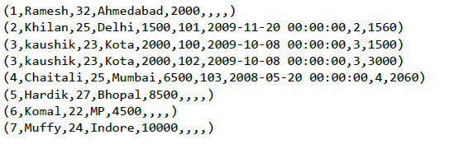
Outer Join
Full outer join 左右表所有行
grunt> outer_full = JOIN customers BY id FULL OUTER, orders BY customer_id;
Notes:
customers.txt
1,Ramesh,32,Ahmedabad,2000.00
2,Khilan,25,Delhi,1500.00
3,kaushik,23,Kota,2000.00
4,Chaitali,25,Mumbai,6500.00
5,Hardik,27,Bhopal,8500.00
6,Komal,22,MP,4500.00
7,Muffy,24,Indore,10000.00
orders.txt
102,2009-10-08 00:00:00,3,3000
100,2009-10-08 00:00:00,3,1500
101,2009-11-20 00:00:00,2,1560
103,2008-05-20 00:00:00,4,2060
customers = LOAD 'hdfs://localhost:9000/pig_data/customers.txt' USING PigStorage(',')as (id:int, name:chararray, age:int, address:chararray, salary:int);
orders = LOAD 'hdfs://localhost:9000/pig_data/orders.txt' USING PigStorage(',')as (oid:int, date:chararray, customer_id:int, amount:int);
例如：
grunt> outer_left = JOIN customers BY id LEFT OUTER, orders BY customer_id;
Dump outer_left;
grunt> outer_right = JOIN customers BY id RIGHT, orders BY customer_id;
grunt> Dump outer_right;
grunt> outer_full = JOIN customers BY id FULL OUTER, orders BY customer_id;
grunt> Dump outer_full;

Slide 44
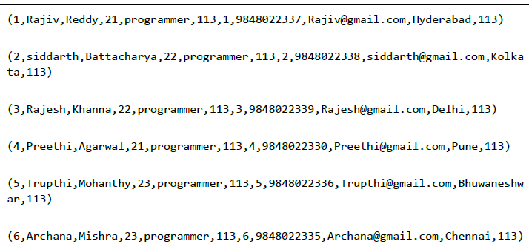
Multiple Keys Join
Relation3_name = JOIN Relation2_name BY (key1, key2), Relation3_name BY (key1, key2);
Notes:
employee.txt
001,Rajiv,Reddy,21,programmer,003
002,siddarth,Battacharya,22,programmer,
003 003,Rajesh,Khanna,22,programmer,003
004,Preethi,Agarwal,21,programmer,003
005,Trupthi,Mohanthy,23,programmer,003
006,Archana,Mishra,23,programmer,003
007,Komal,Nayak,24,teamlead,002
008,Bharathi,Nambiayar,24,manager,001
employee_contact.txt
001,9848022337,Rajiv@gmail.com,Hyderabad,003
002,9848022338,siddarth@gmail.com,Kolkata,003
003,9848022339,Rajesh@gmail.com,Delhi,003
004,9848022330,Preethi@gmail.com,Pune,003
005,9848022336,Trupthi@gmail.com,Bhuwaneshwar,003
006,9848022335,Archana@gmail.com,Chennai,003
007,9848022334,Komal@gmail.com,trivendram,002
008,9848022333,Bharathi@gmail.com,Chennai,001
employee = LOAD 'hdfs://localhost:9000/pig_data/employee.txt' USING PigStorage(',')as (id:int, firstname:chararray, lastname:chararray, age:int, designation:chararray, jobid:int);
employee_contact = LOAD 'hdfs://localhost:9000/pig_data/employee_contact.txt' USING PigStorage(',')as (id:int, phone:chararray, email:chararray, city:chararray, jobid:int);
emp = JOIN employee BY (id,jobid), employee_contact BY (id,jobid);
Dump emp;

Slide 45
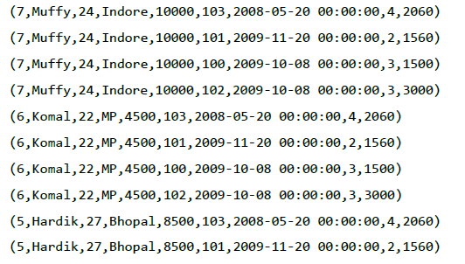
Cross Operator
计算两个表的乘积
Relation3_name = CROSS Relation1_name, Relation2_name;
Notes:
customers.txt
1,Ramesh,32,Ahmedabad,2000.00
2,Khilan,25,Delhi,1500.00
3,kaushik,23,Kota,2000.00
4,Chaitali,25,Mumbai,6500.00
5,Hardik,27,Bhopal,8500.00
6,Komal,22,MP,4500.00
7,Muffy,24,Indore,10000.00
orders.txt
102,2009-10-08 00:00:00,3,3000
100,2009-10-08 00:00:00,3,1500
101,2009-11-20 00:00:00,2,1560
103,2008-05-20 00:00:00,4,2060
customers = LOAD 'hdfs://localhost:9000/pig_data/customers.txt' USING PigStorage(',')as (id:int, name:chararray, age:int, address:chararray, salary:int);
orders = LOAD 'hdfs://localhost:9000/pig_data/orders.txt' USING PigStorage(',')as (oid:int, date:chararray, customer_id:int, amount:int);
cross_data = CROSS customers, orders;
Dump cross_data;

Slide 46
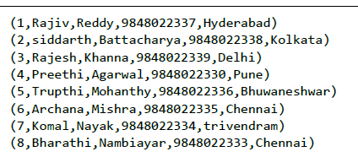
Union
合并两个表，要保证两个表相同的列和域
grunt> Relation_name3 = UNION Relation_name1, Relation_name2;
例：
student = UNION student1, student2;
Notes:
Student_data1.txt
001,Rajiv,Reddy,9848022337,Hyderabad
002,siddarth,Battacharya,9848022338,Kolkata
003,Rajesh,Khanna,9848022339,Delhi
004,Preethi,Agarwal,9848022330,Pune
005,Trupthi,Mohanthy,9848022336,Bhuwaneshwar
006,Archana,Mishra,9848022335,Chennai.
Student_data2.txt
7,Komal,Nayak,9848022334,trivendram.
8,Bharathi,Nambiayar,9848022333,Chennai.
student1 = LOAD 'hdfs://localhost:9000/pig_data/student_data1.txt' USING PigStorage(',') as (id:int, firstname:chararray, lastname:chararray, phone:chararray, city:chararray);
student2 = LOAD 'hdfs://localhost:9000/pig_data/student_data2.txt' USING PigStorage(',') as (id:int, firstname:chararray, lastname:chararray, phone:chararray, city:chararray);
student = UNION student1, student2;
Dump student;

Slide 47
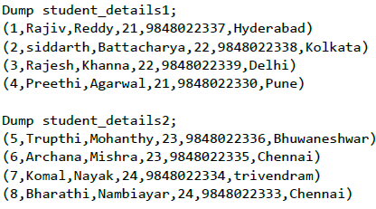
Split
将一个关系表拆分成两个或多个
grunt> SPLIT Relation1_name INTO Relation2_name IF (condition1), Relation2_name (condition2);
例：
SPLIT student_details into student_details1 if age<23, student_details2 if (22<age and age<25);
Notes:
student_details.txt
001,Rajiv,Reddy,21,9848022337,Hyderabad
002,siddarth,Battacharya,22,9848022338,Kolkata
003,Rajesh,Khanna,22,9848022339,Delhi
004,Preethi,Agarwal,21,9848022330,Pune
005,Trupthi,Mohanthy,23,9848022336,Bhuwaneshwar
006,Archana,Mishra,23,9848022335,Chennai
007,Komal,Nayak,24,9848022334,trivendram
008,Bharathi,Nambiayar,24,9848022333,Chennai
student_details = LOAD 'hdfs://localhost:9000/pig_data/student_details.txt' USING PigStorage(',')as (id:int, firstname:chararray, lastname:chararray, age:int, phone:chararray, city:chararray);
SPLIT student_details into student_details1 if age<23, student_details2 if (22<age and age<25);
Dump student_details1;
Dump student_details2;

Slide 48

filter
查询符合条件的元组
grunt> Relation2_name = FILTER Relation1_name BY (condition);
例如：
filter_data = FILTER student_details BY city == 'Chennai';
Notes:
student_details.txt
001,Rajiv,Reddy,21,9848022337,Hyderabad
002,siddarth,Battacharya,22,9848022338,Kolkata
003,Rajesh,Khanna,22,9848022339,Delhi
004,Preethi,Agarwal,21,9848022330,Pune
005,Trupthi,Mohanthy,23,9848022336,Bhuwaneshwar
006,Archana,Mishra,23,9848022335,Chennai
007,Komal,Nayak,24,9848022334,trivendram
008,Bha
student_details = LOAD 'hdfs://localhost:9000/pig_data/student_details.txt' USING PigStorage(',')as (id:int, firstname:chararray, lastname:chararray, age:int, phone:chararray, city:chararray); rathi,Nambiayar,24,9848022333,Chennai
filter_data = FILTER student_details BY city == 'Chennai';
Dump filter_data;

Slide 49
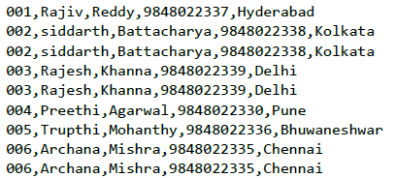
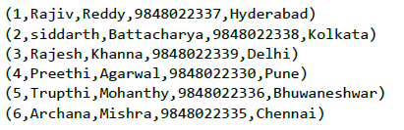
Distinct
去掉重复值，只会对整个记录进行处理，而不是对字段级别进行计算
grunt> Relation_name2 = DISTINCT Relatin_name1;
Notes:
student_details.txt
001,Rajiv,Reddy,9848022337,Hyderabad
002,siddarth,Battacharya,9848022338,Kolkata
002,siddarth,Battacharya,9848022338,Kolkata
003,Rajesh,Khanna,9848022339,Delhi
003,Rajesh,Khanna,9848022339,Delhi
004,Preethi,Agarwal,9848022330,Pune
005,Trupthi,Mohanthy,9848022336,Bhuwaneshwar
006,Archana,Mishra,9848022335,Chennai
006,Archana,Mishra,9848022335,Chennai
student_details = LOAD 'hdfs://localhost:9000/pig_data/student_details.txt' USING PigStorage(',') as (id:int, firstname:chararray, lastname:chararray, phone:chararray, city:chararray);
distinct_data = DISTINCT student_details;
Dump distinct_data;

Slide 50
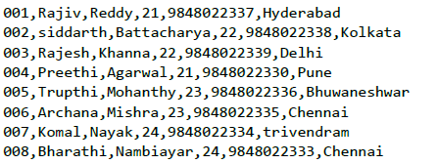
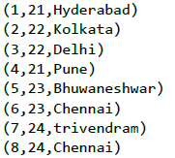
Foreach
根据列数据生成指定的数据转换。
grunt> Relation_name2 = FOREACH Relatin_name1 GENERATE (required data);
例：
foreach_data = FOREACH student_details GENERATE id,age,city;
Notes:
student_details.txt
001,Rajiv,Reddy,21,9848022337,Hyderabad
002,siddarth,Battacharya,22,9848022338,Kolkata
003,Rajesh,Khanna,22,9848022339,Delhi
004,Preethi,Agarwal,21,9848022330,Pune
005,Trupthi,Mohanthy,23,9848022336,Bhuwaneshwar
006,Archana,Mishra,23,9848022335,Chennai
007,Komal,Nayak,24,9848022334,trivendram
008,Bharathi,Nambiayar,24,9848022333,Chennai
student_details = LOAD 'hdfs://localhost:9000/pig_data/student_details.txt' USING PigStorage(',')as (id:int, firstname:chararray, lastname:chararray,age:int, phone:chararray, city:chararray);
foreach_data = FOREACH student_details GENERATE id,age,city;
Dump foreach_data;

Slide 51
Foreach高级应用
flatten
有时用户的数据是存放在bag或tuple中的，而用户想要降低这个嵌套的级别，可以使用flatten
--flatten.pig
players = load 'baseball' as (name:chararray, team:chararray,
position:bag{t:(p:chararray)}, bat:map[]);
pos = foreach players generate name, flatten(position) as position;
bypos = group pos by position;
baseball的第一条记录：
Jorge Posada,New York Yankees,{(Catcher),(Designated_hitter)},...
使用flatten后将会产生两条记录：
Jorge Posada,Catcher
Jorge Posada,Designated_hitter
Notes:
Jorge Posada,New York Yankees,{(Catcher),(Designated_hitter)},...
使用flatten
Jorge Posada,Catcher
Jorge Posada,Designated_hitter

Slide 52
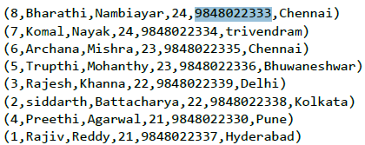
ORDER BY
对用户的数据进行排序
grunt> Relation_name2 = ORDER Relatin_name1 BY (ASC|DESC);
Notes:
student_details.txt
001,Rajiv,Reddy,21,9848022337,Hyderabad
002,siddarth,Battacharya,22,9848022338,Kolkata
003,Rajesh,Khanna,22,9848022339,Delhi
004,Preethi,Agarwal,21,9848022330,Pune
005,Trupthi,Mohanthy,23,9848022336,Bhuwaneshwar
006,Archana,Mishra,23,9848022335,Chennai
007,Komal,Nayak,24,9848022334,trivendram
008,Bharathi,Nambiayar,24,9848022333,Chennai
student_details = LOAD 'hdfs://localhost:9000/pig_data/student_details.txt' USING PigStorage(',')as (id:int, firstname:chararray, lastname:chararray,age:int, phone:chararray, city:chararray);
order_by_data = ORDER student_details BY age DESC;
Dump order_by_data;

Slide 53
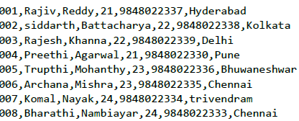
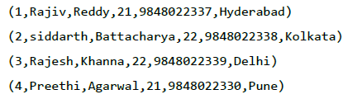
Limit
返回最多n行
grunt> Result = LIMIT Relation_name required number of tuples;
Notes:
student_details.txt
001,Rajiv,Reddy,21,9848022337,Hyderabad
002,siddarth,Battacharya,22,9848022338,Kolkata
003,Rajesh,Khanna,22,9848022339,Delhi
004,Preethi,Agarwal,21,9848022330,Pune
005,Trupthi,Mohanthy,23,9848022336,Bhuwaneshwar
006,Archana,Mishra,23,9848022335,Chennai
007,Komal,Nayak,24,9848022334,trivendram
008,Bharathi,Nambiayar,24,9848022333,Chennai
student_details = LOAD 'hdfs://localhost:9000/pig_data/student_details.txt' USING PigStorage(',')as (id:int, firstname:chararray, lastname:chararray,age:int, phone:chararray, city:chararray);
limit_data = LIMIT student_details 4;
Dump limit_data;

Slide 54
函数
eval, load/store, math, string, bag, tuple

Slide 55
Eval 函数
AVG
Max
Min
Count
COUNT_STAR
Sum
DIFF
SUBTRACT
IsEmpty
Pluck Tuple
Size ( )
BagToString ( )
Concat ( )
Tokenize ( )

Slide 56
Eval函数-AVG()
计算bag中一列的平均值
Group All //取得全部数据的平均值
Gropu By //取得一组数据的平均值
grunt> AVG(expression)
例子详见备注
Notes:
student_details.txt
001,Rajiv,Reddy,21,9848022337,Hyderabad,89
002,siddarth,Battacharya,22,9848022338,Kolkata,78
003,Rajesh,Khanna,22,9848022339,Delhi,90
004,Preethi,Agarwal,21,9848022330,Pune,93
005,Trupthi,Mohanthy,23,9848022336,Bhuwaneshwar,75
006,Archana,Mishra,23,9848022335,Chennai,87
007,Komal,Nayak,24,9848022334,trivendram,83
008,Bharathi,Nambiayar,24,9848022333,Chennai,72
grunt> student_details = LOAD 'hdfs://localhost:9000/pig_data/student_data.txt' USING PigStorage(',')as (id:int, firstname:chararray, lastname:chararray, age:int, phone:chararray, city:chararray, gpa:int);
grunt> student_group_all = Group student_details All;
grunt> Dump student_group_all;
grunt> student_gpa_avg = foreach student_group_all Generate (student_details.firstname, student_details.gpa), AVG(student_details.gpa);
grunt> Dump student_gpa_avg;

Slide 57
Eval函数-Max()/Min()
获取bag某列中最大/最小值
Group All //取得全部数据的最大/最小值
Gropu By //取得一组数据的最大/最小值
grunt> Max(expression)
例子详见备注
Notes:
student_details.txt
001,Rajiv,Reddy,21,9848022337,Hyderabad,89
002,siddarth,Battacharya,22,9848022338,Kolkata,78
003,Rajesh,Khanna,22,9848022339,Delhi,90
004,Preethi,Agarwal,21,9848022330,Pune,93
005,Trupthi,Mohanthy,23,9848022336,Bhuwaneshwar,75
006,Archana,Mishra,23,9848022335,Chennai,87
007,Komal,Nayak,24,9848022334,trivendram,83
008,Bharathi,Nambiayar,24,9848022333,Chennai,72
grunt> student_details = LOAD 'hdfs://localhost:9000/pig_data/student_data.txt' USING PigStorage(',')as (id:int, firstname:chararray, lastname:chararray, age:int, phone:chararray, city:chararray, gpa:int);
grunt> student_group_all = Group student_details All;
grunt> Dump student_group_all;
grunt> student_gpa_max = foreach student_group_all Generate (student_details.firstname, student_details.gpa), MAX(student_details.gpa);
grunt> Dump student_gpa_max;

Slide 58
Eval函数-Count()
取得bag中元组的个数
Group All //取得全部数据元组的个数
Gropu By //取得一组数据元组的个数
grunt> COUNT(expression)
例子详见备注
Notes:
student_details.txt
001,Rajiv,Reddy,21,9848022337,Hyderabad,89
002,siddarth,Battacharya,22,9848022338,Kolkata,78
003,Rajesh,Khanna,22,9848022339,Delhi,90
004,Preethi,Agarwal,21,9848022330,Pune,93
005,Trupthi,Mohanthy,23,9848022336,Bhuwaneshwar,75
006,Archana,Mishra,23,9848022335,Chennai,87
007,Komal,Nayak,24,9848022334,trivendram,83
008,Bharathi,Nambiayar,24,9848022333,Chennai,72
grunt> student_details = LOAD 'hdfs://localhost:9000/pig_data/student_data.txt' USING PigStorage(',')as (id:int, firstname:chararray, lastname:chararray, age:int, phone:chararray, city:chararray, gpa:int);
grunt> student_group_all = Group student_details All;
grunt> Dump student_group_all;
grunt> student_count = foreach student_group_all Generate COUNT(student_details.gpa);
grunt> Dump student_count;

Slide 59
Eval函数-Sum()
计算bag中某一列的和
Group All
Group By
grunt> SUM(expression)
例子详见备注
Notes:
employee.txt
1,John,2007-01-24,250
2,Ram,2007-05-27,220
3,Jack,2007-05-06,170
3,Jack,2007-04-06,100
4,Jill,2007-04-06,220
5,Zara,2007-06-06,300
5,Zara,2007-02-06,350
grunt> employee_data = LOAD 'hdfs://localhost:9000/pig_data/ employee.txt' USING PigStorage(',')as (id:int, name:chararray, workdate:chararray, daily_typing_pages:int);
grunt> employee_group = Group employee_data all;
grunt> Dump employee_group;
grunt> student_workpages_sum = foreach employee_group Generate (employee_data.name,employee_data.daily_typing_pages),SUM(employee_data.daily_typing_pages);
grunt> Dump student_workpages_sum;
Output
(({ (Zara), (Zara), (Jill) ,(Jack) , (Jack) , (Ram) , (John) },
{ (350) , (300) , (220) ,(100) , (170) , (220) , (250) }),1610)

Slide 60
Eval函数-IsEmpty()
检查bag或者map是否为空
IsEmpty(expression)
例子详见备注
Notes:
emp_sales.txt
1,Robin,22,25000,sales
2,BOB,23,30000,sales
3,Maya,23,25000,sales
4,Sara,25,40000,sales
5,David,23,45000,sales
6,Maggy,22,35000,sales
emp_bonus.txt
1,Robin,22,25000,sales
2,Jaya,23,20000,admin
3,Maya,23,25000,sales
4,Alia,25,50000,admin
5,David,23,45000,sales
6,Omar,30,30000,admin
emp_sales = LOAD 'hdfs://localhost:9000/pig_data/emp_sales.txt' USING PigStorage(',')as (sno:int, name:chararray, age:int, salary:int, dept:chararray);
emp_bonus = LOAD 'hdfs://localhost:9000/pig_data/emp_bonus.txt' USING PigStorage(',')as (sno:int, name:chararray, age:int, salary:int, dept:chararray);
cogroup_data = COGROUP emp_sales by sno, emp_bonus by age;
grunt> Dump cogroup_data;
isempty_data = filter cogroup_data by IsEmpty(emp_sales);
Dump isempty_data;

Slide 61
Load and Store 函数
PigStorage ( )
TextLoader ( )
BinStorage ( )
Handling Compression

Slide 62
Load and Store函数-PigStorage()
对应使用制定分隔符分割的文本格式，默认为 tab
PigStorage(field_delimiter)
例子详见备注
Notes:
student_data.txt
001,Rajiv,Reddy,9848022337,Hyderabad
002,siddarth,Battacharya,9848022338,Kolkata
003,Rajesh,Khanna,9848022339,Delhi
004,Preethi,Agarwal,9848022330,Pune
005,Trupthi,Mohanthy,9848022336,Bhuwaneshwar
006,Archana,Mishra,9848022335,Chennai.
grunt> student = LOAD 'hdfs://localhost:9000/pig_data/student_data.txt' USING PigStorage(',')as ( id:int, firstname:chararray, lastname:chararray, phone:chararray, city:chararray );
STORE student INTO ' hdfs://localhost:9000/pig_Output/ ' USING PigStorage (',');
检验：
$ hdfs dfs -ls 'hdfs://localhost:9000/pig_Output/'
$ hdfs dfs -cat 'hdfs://localhost:9000/pig_Output/part-m-00000'

Slide 63
Load and Store函数-TextLoader()
用来读入文本，每行一个 chararray，builtin
TextLoader()
例子详见备注
Notes:
stu_data.txt
001,Rajiv_Reddy,21,Hyderabad
002,siddarth_Battacharya,22,Kolkata
003,Rajesh_Khanna,22,Delhi
004,Preethi_Agarwal,21,Pune
005,Trupthi_Mohanthy,23,Bhuwaneshwar
006,Archana_Mishra,23,Chennai
007,Komal_Nayak,24,trivendram
008,Bharathi_Nambiayar,24,Chennai
grunt> details = LOAD 'hdfs://localhost:9000/pig_data/stu_data.txt' USING TextLoader();
grunt> dump;

Slide 64
Load and Store函数-BinStorage()
用机器可读的格式加载/存储数据。通常用来做MR作业的临时数据，支持多个位置的输入。
BinStorage();
Notes:
Stu_data.txt
001,Rajiv_Reddy,21,Hyderabad
002,siddarth_Battacharya,22,Kolkata
003,Rajesh_Khanna,22,Delhi
004,Preethi_Agarwal,21,Pune
005,Trupthi_Mohanthy,23,Bhuwaneshwar
006,Archana_Mishra,23,Chennai
007,Komal_Nayak,24,trivendram
008,Bharathi_Nambiayar,24,Chennai
student_details = LOAD 'hdfs://localhost:9000/pig_data/stu_data.txt' USING PigStorage(',')as (id:int, firstname:chararray, age:int, city:chararray);
STORE student_details INTO 'hdfs://localhost:9000/pig_Output/mydata' USING BinStorage();
sbin]$ hdfs dfs -ls hdfs://localhost:9000/pig_Output/mydata/
result = LOAD 'hdfs://localhost:9000/pig_Output/b/part-m-00000' USING BinStorage();
Dump result;
(1,Rajiv_Reddy,21,Hyderabad)
(2,siddarth_Battacharya,22,Kolkata)
(3,Rajesh_Khanna,22,Delhi)
(4,Preethi_Agarwal,21,Pune)
(5,Trupthi_Mohanthy,23,Bhuwaneshwar)
(6,Archana_Mishra,23,Chennai)
(7,Komal_Nayak,24,trivendram)
(8,Bharathi_Nambiayar,24,Chennai)

Slide 65
Load and Store函数-压缩
使用BinStorage()和TextLoader()加载/存储压缩数据
Notes:
employee.txt.zip
Using PigStorage:
grunt > data = LOAD 'hdfs://localhost:9000/pig_data/employee.txt.zip' USING PigStorage(',');
Using TextLoader:
grunt > data = LOAD 'hdfs://localhost:9000/pig_data/employee.txt.zip' USING TextLoader;
Using PigStorage:
grunt> store data INTO 'hdfs://localhost:9000/pig_Output/data.bz' USING PigStorage(',');

Slide 66
Bag and Tuple 函数
TOBAG ( )
TOP ( )
TOTUPLE ( )
TOMAP ( )

Slide 67
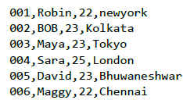
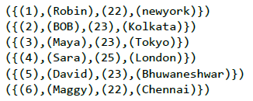
Bag and Tuple 函数-TOBAG()
将两个或多个表达式转化成一个bag
TOBAG(expression [, expression ...])
例子详见备注
Notes:
employee_details.txt
001,Robin,22,newyork
002,BOB,23,Kolkata
003,Maya,23,Tokyo
004,Sara,25,London
005,David,23,Bhuwaneshwar
006,Maggy,22,Chennai
grunt> emp_data = LOAD 'hdfs://localhost:9000/pig_data/employee_details.txt' USING PigStorage(',')as (id:int, name:chararray, age:int, city:chararray);
tobag = FOREACH emp_data GENERATE TOBAG (id,name,age,city);
DUMP tobag;
({(1),(Robin),(22),(newyork)})
({(2),(BOB),(23),(Kolkata)})
({(3),(Maya),(23),(Tokyo)})
({(4),(Sara),(25),(London)})
({(5),(David),(23),(Bhuwaneshwar)})
({(6),(Maggy),(22),(Chennai)})

Slide 68
Bag and Tuple 函数-TOP()
获得bag中前N个tuples
TOP(topN,column,relation)
例如，详见备注
data_top = FOREACH emp_group {
top = TOP(2, 0, emp_data);
GENERATE top;
}
Notes:
employee_details.txt
001,Robin,22,newyork
002,BOB,23,Kolkata
003,Maya,23,Tokyo
004,Sara,25,London
005,David,23,Bhuwaneshwar
006,Maggy,22,Chennai
007,Robert,22,newyork
008,Syam,23,Kolkata
009,Mary,25,Tokyo
010,Saran,25,London
011,Stacy,25,Bhuwaneshwar
012,Kelly,22,Chennai
grunt> emp_data = LOAD 'hdfs://localhost:9000/pig_data/ employee_details.txt' USING PigStorage(',') as (id:int, name:chararray, age:int, city:chararray);
emp_group = Group emp_data BY age;
Dump emp_group;
data_top = FOREACH emp_group {
top = TOP(2, 0, emp_data);
GENERATE top;
}
Dump data_top;
({(7,Robert,22,newyork),(12,Kelly,22,Chennai)})
({(5,David,23,Bhuwaneshwar),(8,Syam,23,Kolkata)})
({(10,Saran,25,London),(11,Stacy,25,Bhuwaneshwar)})

Slide 69
Bag and Tuple 函数-TOTUPLE()
将两个或多个表达式转换tupleTOTUPLE(expression [, expression ...])
例如，详见备注
totuple = FOREACH emp_data GENERATE TOTUPLE (id,name,age);
Notes:
employee_details.txt
001,Robin,22,newyork
002,BOB,23,Kolkata
003,Maya,23,Tokyo
004,Sara,25,London
005,David,23,Bhuwaneshwar
006,Maggy,22,Chennai
grunt> emp_data = LOAD 'hdfs://localhost:9000/pig_data/employee_details.txt' USING PigStorage(',')as (id:int, name:chararray, age:int, city:chararray);
totuple = FOREACH emp_data GENERATE TOTUPLE (id,name,age);
DUMP totuple;
((1,Robin,22))
((2,BOB,23))
((3,Maya,23))
((4,Sara,25))
((5,David,23))
((6,Maggy,22))

Slide 70
Bag and Tuple 函数-TOMAP()
key-value键值对转化为Map
TOMAP(key-expression, value-expression [, key-expression, value-expression ...])
例如，详见备注
tomap = FOREACH emp_data GENERATE TOMAP(name, age);
Notes:
employee_details.txt
001,Robin,22,newyork
002,BOB,23,Kolkata
003,Maya,23,Tokyo
004,Sara,25,London
005,David,23,Bhuwaneshwar
006,Maggy,22,Chennai
grunt> emp_data = LOAD 'hdfs://localhost:9000/pig_data/employee_details.txt' USING PigStorage(',')as (id:int, name:chararray, age:int, city:chararray);
tomap = FOREACH emp_data GENERATE TOMAP(name, age);
DUMP tomap;
([Robin#22]) ([BOB#23]) ([Maya#23]) ([Sara#25]) ([David#23]) ([Maggy#22])

Slide 71
String 函数
STARTSWITH ( )
ENDSWITH
SUBSTRING
EqualsIgnoreCase
INDEXOF ( )
LAST_INDEX_OF ( )
LCFIRST ( )
UCFIRST ( )
UPPER ( )
LOWER ( )
REPLACE ( )
STRSPLIT ( )
STRSPLITTOBAG ( )
Trim ( )
LTRIM ( )
RTRIM

Slide 72
String函数-STARTSWITH()/ENDSWITH()
检验是否以给定字符串开始/结束
STARTSWITH(string, substring)
例如，详见备注
grunt> startswith_data = FOREACH emp_data GENERATE (id,name), STARTSWITH (name,’Ro’);
Notes:
emp.txt
001,Robin,22,newyork
002,BOB,23,Kolkata
003,Maya,23,Tokyo
004,Sara,25,London
005,David,23,Bhuwaneshwar
006,Maggy,22,Chennai
007,Robert,22,newyork
008,Syam,23,Kolkata
009,Mary,25,Tokyo
010,Saran,25,London
011,Stacy,25,Bhuwaneshwar
012,Kelly,22,Chennai
grunt > emp_data = LOAD 'hdfs://localhost:9000/pig_data/emp1.txt' USING PigStorage(',')as (id:int, name:chararray, age:int, city:chararray);
grunt> startswith_data = FOREACH emp_data GENERATE (id,name), STARTSWITH (name,’Ro’);
Dump startswith_data;
((1,Robin),true)
((2,BOB),false)
((3,Maya),false)
((4,Sara),false)
((5,David),false)
((6,maggy),false)
((7,Robert),true)
((8,Syam),false)
((9,Mary),false)
((10,Saran),false)
((11,Stacy),false)
((12,Kelly),false)

Slide 73
String函数-SUBSTRING()
三个参数，第一是列名，第二个是开始字符串，第三个是结束字符串
SUBSTRING(string, startIndex, stopIndex)
Notes:
emp.txt
001,Robin,22,newyork
002,BOB,23,Kolkata
003,Maya,23,Tokyo
004,Sara,25,London
005,David,23,Bhuwaneshwar
006,Maggy,22,Chennai
007,Robert,22,newyork
008,Syam,23,Kolkata
009,Mary,25,Tokyo
010,Saran,25,London
011,Stacy,25,Bhuwaneshwar
012,Kelly,22,Chennai
grunt > emp_data = LOAD 'hdfs://localhost:9000/pig_data/emp1.txt' USING PigStorage(',')as (id:int, name:chararray, age:int, city:chararray);
grunt> substring_data = FOREACH emp_data GENERATE (id,name), STARTSWITH (name,’Ro’);
Dump startswith_data;
((1,Robin),true)
((2,BOB),false)
((3,Maya),false)
((4,Sara),false)
((5,David),false)
((6,maggy),false)
((7,Robert),true)
((8,Syam),false)
((9,Mary),false)
((10,Saran),false)
((11,Stacy),false)
((12,Kelly),false)

Slide 74
String函数-EqualsIgnoreCase()
比较两个字符串是否相同
EqualsIgnoreCase(string1, string2)
Notes:
emp.txt
001,Robin,22,newyork
002,BOB,23,Kolkata
003,Maya,23,Tokyo
004,Sara,25,London
005,David,23,Bhuwaneshwar
006,Maggy,22,Chennai
007,Robert,22,newyork
008,Syam,23,Kolkata
009,Mary,25,Tokyo
010,Saran,25,London
011,Stacy,25,Bhuwaneshwar
012,Kelly,22,Chennai
grunt > emp_data = LOAD 'hdfs://localhost:9000/pig_data/emp1.txt' USING PigStorage(',')as (id:int, name:chararray, age:int, city:chararray);
grunt> equals_data = FOREACH emp_data GENERATE (id,name), EqualsIgnoreCase(name, 'Robin');
grunt> Dump equals_data;
((1,Robin),true)
((2,BOB),false)
((3,Maya),false)
((4,Sara),false)
((5,David),false)
((6,Maggy),false)
((7,Robert),false)
((8,Syam),false)
((9,Mary),false)
((10,Saran),false)
((11,Stacy),false)
((12,Kelly),false)

Slide 75
String函数-UPPER()/LOWER()
将所有字符串转化为大写/小写
UPPER(expression)
Notes:
emp.txt
001,Robin,22,newyork
002,BOB,23,Kolkata
003,Maya,23,Tokyo
004,Sara,25,London
005,David,23,Bhuwaneshwar
006,Maggy,22,Chennai
007,Robert,22,newyork
008,Syam,23,Kolkata
009,Mary,25,Tokyo
010,Saran,25,London
011,Stacy,25,Bhuwaneshwar
012,Kelly,22,Chennai
grunt > emp_data = LOAD 'hdfs://localhost:9000/pig_data/emp1.txt' USING PigStorage(',')as (id:int, name:chararray, age:int, city:chararray);
grunt> upper_data = FOREACH emp_data GENERATE (id,name), UPPER(name);
Dump upper_data;
((1,Robin),ROBIN)
((2,BOB),BOB)
((3,Maya),MAYA)
((4,Sara),SARA)
((5,David),DAVID)
((6,Maggy),MAGGY)
((7,Robert),ROBERT)
((8,Syam),SYAM)
((9,Mary),MARY)
((10,Saran),SARAN)
((11,Stacy),STACY)
((12,Kelly),KELLY)

Slide 76
date-time 函数
CurrentTime ( )
ToString ( )
DaysBetween ( )
HoursBetween ( )
MinutesBetween ( )
SecondsBetween ( )
MilliSecondsBetween ( )
YearsBetween ( )
MonthsBetween ( )
WeeksBetween ( )
AddDuration ( )
SubtractDuration ( )
ToDate ( )
GetDay ( )
GetHour ( )
GetMinute ( )
GetSecond ( )
GetMilliSecond ( )
GetYear
GetMonth ( )
GetWeek ( )
GetWeekYear ( )

Slide 77
date-time函数-ToDate()
生成一个DateTime,接受一下类型参数
ToDate(milliseconds)
ToDate(iosstring)
ToDate(userstring, format)
ToDate(userstring, format, timezone)
例子详见备注
Notes:
date.txt
001,1989/09/26 09:00:00
002,1980/06/20 10:22:00
003,1990/12/19 03:11:44
grunt > raw_date = LOAD 'hdfs://localhost:9000/pig_data/date.txt' USING PigStorage(',')as (id:int,date:chararray);
grunt todate_data = foreach raw_date generate ToDate(date,'yyyy/MM/dd HH:mm:ss') as (date_time:DateTime >);
Dump todate_data;
(1989-09-26T09:00:00.000+05:30)
(1980-06-20T10:22:00.000+05:30)
(1990-12-19T03:11:44.000+05:30)

Slide 78
date-time函数-GetDay()
相似的函数有：GetHour()/GetMinute()/GetSecond()/GetMilliSecond()/ GetYear()/GetMonth()/GetWeek()/GetWeekYear()
GetDay(datetime)
Notes:
date.txt
001,1989/09/26 09:00:00
002,1980/06/20 10:22:00
003,1990/12/19 03:11:44
grunt > raw_date = LOAD 'hdfs://localhost:9000/pig_data/date.txt' USING PigStorage(',')as (id:int,date:chararray);
grunt todate_data = foreach raw_date generate ToDate(date,'yyyy/MM/dd HH:mm:ss') as (date_time:DateTime );
Dump todate_data;
(1989-09-26T09:00:00.000+05:30)
(1980-06-20T10:22:00.000+05:30)
(1990-12-19T03:11:44.000+05:30)
getday_data = foreach todate_data generate(date_time), GetDay(date_time);
Dump getday_data;
(1989-09-26T09:00:00.000+05:30,26)
(1980-06-20T10:22:00.000+05:30,20)
(1990-12-19T03:11:44.000+05:30,19)

Slide 79
date-time函数-CurrentTime()
生成当前时间的DateTime
CurrentTime()
Notes:
date.txt
001,1989/09/26 09:00:00
002,1980/06/20 10:22:00
003,1990/12/19 03:11:44
grunt > raw_date = LOAD 'hdfs://localhost:9000/pig_data/date.txt' USING PigStorage(',')as (id:int,date:chararray);
grunt> currenttime_data = foreach todate_data generate CurrentTime();
Dump currenttime_data;
(2015-11-06T11:31:02.013+05:30)
(2015-11-06T11:31:02.013+05:30)
(2015-11-06T11:31:02.013+05:30)

Slide 80
date-time函数-ToString()
将date-time类型转化为指定类型字符串
ToString(datetime [, format string])
Notes:
date.txt
001,1989/09/26 09:00:00
002,1980/06/20 10:22:00
003,1990/12/19 03:11:44
grunt > raw_date = LOAD 'hdfs://localhost:9000/pig_data/date.txt' USING PigStorage(',')as (id:int,date:chararray);
grunt todate_data = foreach raw_date generate ToDate(date,'yyyy/MM/dd HH:mm:ss') as (date_time:DateTime );
Dump todate_data;
(1989-09-26T09:00:00.000+05:30)
(1980-06-20T10:22:00.000+05:30)
(1990-12-19T03:11:44.000+05:30)

Slide 81
Math函数
ABS ( )
ACOS ( )
ASIN ( )
ATAN ( )
CBRT ( )
CEIL ( )
COS ( )
COSH ( )
EXP ( )
FLOOR ( )
LOG ( )
LOG10 ( )
RANDOM ( )
ROUND ( )
SIN ( )
SINH ( )
SQRT ( )
TAN ( )
TANH ( )

Slide 82
Math函数-ABS()
绝对值
ABS(expression)
Notes:
math.txt
5
16
9
2.5
5.9
3.1
math_data = LOAD 'hdfs://localhost:9000/pig_data/math.txt' USING PigStorage(',')as (data:float);
abs_data = foreach math_data generate (data), ABS(data);
Dump abs_data;
(5.0,5.0)
(16.0,16.0)
(9.0,9.0)
(2.5,2.5)
(5.9,5.9)
(3.1,3.1)

Slide 83
Math函数-EXP()
指数函数
EXP(expression)
Notes:
math.txt
5
16
9
2.5
5.9
3.1
math_data = LOAD 'hdfs://localhost:9000/pig_data/math.txt' USING PigStorage(',')as (data:float);
exp_data = foreach math_data generate (data), EXP(data);
Dump exp_data;
(5.0,148.4131591025766)
(16.0,8886110.520507872)
(9.0,8103.083927575384)
(2.5,12.182493960703473)
(5.9,365.0375026780162)
(3.1,22.197949164480132)

Slide 84
Math函数-LOG()
对数函数
LOG(expression)
Notes:
math.txt
5
16
9
2.5
5.9
3.1
math_data = LOAD 'hdfs://localhost:9000/pig_data/math.txt' USING PigStorage(',')as (data:float);
log_data = foreach math_data generate (data),LOG(data);
Dump log_data;
(5.0,1.6094379124341003)
(16.0,2.772588722239781)
(9.0,2.1972245773362196)
(2.5,0.9162907318741551)
(5.9,1.774952367075645)
(3.1,1.1314020807274126)

Slide 85
Math函数-SQRT()
平方根
SQRT(expression)
Notes:
math.txt
5
16
9
2.5
5.9
3.1
math_data = LOAD 'hdfs://localhost:9000/pig_data/math.txt' USING PigStorage(',')as (data:float);
sqrt_data = foreach math_data generate (data), SQRT(data);
Dump sqrt_data;
(5.0,2.23606797749979)
(16.0,4.0)
(9.0,3.0)
(2.5,1.5811388300841898)
(5.9,2.4289915799292987)
(3.1,1.76068165908337)

Slide 86
Math函数-RANDOM()
随机数
RANDOM()
Notes:
math.txt
5
16
9
2.5
5.9
3.1
math_data = LOAD 'hdfs://localhost:9000/pig_data/math.txt' USING PigStorage(',')as (data:float);
random_data = foreach math_data generate (data), RANDOM();
Dump random_data;
(5.0,0.6842057767279982)
(16.0,0.9725172591786139)
(9.0,0.4159326414649489)
(2.5,0.30962777780713147)
(5.9,0.705213727551145)
(3.1,0.24247708413861724)

Slide 87
UDF
用户自定义函数
支持六种编程语言：Java, Jython, Python, JavaScript, Ruby和Groovy.
Java支持所有的功能，其他语言则只支持有限的功能。
Pig中，也有一个Java UDF仓库，叫做Piggybank，使用Piggybank我们可以访问其他用户编写的java UDF，也可以把我们编写的UDF贡献给别人使用。

Slide 88
UDF
UDF类型
Filter Functions
Eval Functions
Algebraic Functions

Slide 89
UDF
编写UDF步骤
打开Eclipse，创建一个新工程（叫做myproject）；
将新建的工程转换为Maven工程；
修改pom.xml的内容，详见备注；
保存文件，并刷新。在Maven Dependencies部分，你可以找到下载的jar包；
新建类Sample_Eval继承自EvalFunc；实例详见备注
导出Sample_Eval.java的jar包；（sample_udf.jar）
Notes:
pom.xml的内容：
<project xmlns="http://maven.apache.org/POM/4.0.0" xmlns:xsi="http://www.w3.org/2001/XMLSchema-instance" xsi:schemaLocation="http://maven.apache.org/POM/4.0.0http://maven.apache.org/xsd/maven-4.0.0.xsd">
<modelVersion>4.0.0</modelVersion> <groupId>Pig_Udf</groupId> <artifactId>Pig_Udf</artifactId> <version>0.0.1-SNAPSHOT</version> <build> <sourceDirectory>src</sourceDirectory> <plugins> <plugin> <artifactId>maven-compiler-plugin</artifactId> <version>3.3</version> <configuration> <source>1.7</source> <target>1.7</target> </configuration> </plugin> </plugins> </build> <dependencies> <dependency> <groupId>org.apache.pig</groupId> <artifactId>pig</artifactId> <version>0.15.0</version> </dependency> <dependency> <groupId>org.apache.hadoop</groupId> <artifactId>hadoop-core</artifactId> <version>0.20.2</version> </dependency> </dependencies> </project>
Sample_Eval.java内容：
import java.io.IOException; import org.apache.pig.EvalFunc; import org.apache.pig.data.Tuple; import java.io.IOException; import org.apache.pig.EvalFunc; import org.apache.pig.data.Tuple; Apache Pig
194
public class Sample_Eval extends EvalFunc<String>{ public String exec(Tuple input) throws IOException {
if (input == null || input.size() == 0) return null; String str = (String)input.get(0); return str.toUpperCase(); } }

Slide 90
UDF
使用UDF步骤
注册UDF Jar;
语法： REGISTER path;
例如： $cd PIG_HOME/bin
$./pig –x local
> REGISTER '/home/Hadoop/Pig/pig_data/sample_udf.jar'
Define；
语法： DEFINE alias {function | [`command` [input] [output] [ship] [cache] [stderr] ] };
例如： DEFINE sample_eval sample_eval();
使用，见备注中的例子；
Notes:
emp1.txt：
001,Robin,22,newyork
002,BOB,23,Kolkata
003,Maya,23,Tokyo
004,Sara,25,London
005,David,23,Bhuwaneshwar
006,Maggy,22,Chennai
007,Robert,22,newyork
008,Syam,23,Kolkata
009,Mary,25,Tokyo
010,Saran,25,London
011,Stacy,25,Bhuwaneshwar
012,Kelly,22,Chennai
emp_data = LOAD 'hdfs://localhost:9000/pig_data/emp1.txt' USING PigStorage(',')as (id:int, name:chararray, age:int, city:chararray);
Upper_case = FOREACH emp_data GENERATE sample_eval(name);
Dump Upper_case;

Slide 91
运行脚本
编写脚本
编写后缀名为.pig的脚本
脚本中多行注释 /*多行注释*/，单行注释 --注释内容
运行脚本
本地模式 $ pig -x local Sample_script.pig
hadoop模式 $ pig -x mapreduce Sample_script.pig
grunt模式 grunt> exec /sample_script.pig
参考备注中的例子
Notes:
student_details.txt
001,Rajiv,Reddy,21,9848022337,Hyderabad
002,siddarth,Battacharya,22,9848022338,Kolkata
003,Rajesh,Khanna,22,9848022339,Delhi
004,Preethi,Agarwal,21,9848022330,Pune
005,Trupthi,Mohanthy,23,9848022336,Bhuwaneshwar
006,Archana,Mishra,23,9848022335,Chennai
007,Komal,Nayak,24,9848022334,trivendram
008,Bharathi,Nambiayar,24,9848022333,Chennai
sample_script.pig
student = LOAD 'hdfs://localhost:9000/pig_data/student_data.txt' USING PigStorage(',')as (id:int, firstname:chararray, lastname:chararray, phone:chararray, city:chararray);
student_order = ORDER student_details BY age DESC;
student_limit = LIMIT student_details 4;
Dump student_limit;
$./pig -x mapreduce hdfs://localhost:9000/pig_data/sample_script.pig

Slide 92
在Pig中集成遗留代码和MR程序
stream
如果想在数据流中插入一个个性化的可执行任务，那么可以使用stream功能。当有一个一流的程序同事不想去修改它或是不能修改它的时候，会使用到这个功能。
--streamship.pig
define hd `highdiv.pl` ship('highdiv.pl');
divs = load 'NYSE_dividends' as (exchange, symbol, date, dividends);
highdivs = stream divs through hd as (exchange, symbol, date, dividends);
define hd `highdiv.pl` ship('highdiv.pl', 'Financial.pm');
divs = load 'NYSE_dividends' as (exchange, symbol, date, dividends);
highdivs = stream divs through hd as (exchange, symbol, date, dividends);
Notes:
--streamship.pig
define hd `highdiv.pl` ship('highdiv.pl');
divs = load 'NYSE_dividends' as (exchange, symbol, date, dividends);
highdivs = stream divs through hd as (exchange, symbol, date, dividends);
define hd `highdiv.pl` ship('highdiv.pl', 'Financial.pm');
divs = load 'NYSE_dividends' as (exchange, symbol, date, dividends);
highdivs = stream divs through hd as (exchange, symbol, date, dividends);
crawl = load 'webcrawl' as (url, pageid);
normalized = foreach crawl generate normalize(url);
define blc `blacklistchecker.py` cache('/data/shared/badurls#badurls');
goodurls = stream normalized through blc as (url, pageid);
crawl = load 'webcrawl' as (url, pageid);
normalized = foreach crawl generate normalize(url);
define blc `blacklistchecker.py -i urls -o good` input('urls') output('good');
goodurls = stream normalized through blc as (url, pageid);

Slide 93
在Pig中集成遗留代码和MR程序
mapreduce
从0.8版本开始，通过mapreduce命令可以在数据流中直接添加MapReduce任务。
crawl = load 'webcrawl' as (url, pageid);
normalized = foreach crawl generate normalize(url);
goodurls = mapreduce 'blacklistchecker.jar'
store normalized into 'input'
load 'output' as (url, pageid);
crawl = load 'webcrawl' as (url, pageid);
normalized = foreach crawl generate normalize(url);
goodurls = mapreduce 'blacklistchecker.jar'
store normalized into 'input'
load 'output' as (url, pageid)
`com.acmeweb.security.BlackListChecker -i input -o output`;

Slide 94
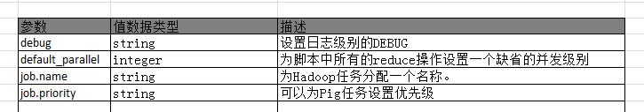
在Pig中集成遗留代码和MR程序
执行过程控制-set
set命令用于设置Pig执行MR任务的环境变量。

Slide 95
在Pig中集成遗留代码和MR程序
执行过程控制-设置分割器
Hadoop使用一个叫做Partitioner的类在shuffle阶段来对记录进行划分，然后传送给reducer。
register acme.jar; --jar containing the partitioner
users = load 'users' as (id, age, zip);
grp = group users by id partition by com.acme.userpartitioner parallel 100;

Slide 96
Pig Latin预处理器
在Pig Latin脚本被解析前会有一个预处理器。在0.8或更早版本中，提供了参数替换代入，粗略地和简化版的C语言中#define命令相同。从0.9版本开始，同样提供了其他Pig Latin脚本和类函数宏定义，因此可以以模块化的方式来写Pig Latin脚本。

Slide 97
Pig Latin预处理器
参数传入
--daily.pig
daily = load 'NYSE_daily' as (exchange:chararray, symbol:chararray,
date:chararray, open:float, high:float, low:float, close:float,
volume:int, adj_close:float);
yesterday = filter daily by date == '$DATE';
grpd = group yesterday all;
minmax = foreach grpd generate MAX(yesterday.high), MIN(yesterday.low);
会提示没有定义的参数
pig -p DATE=2009-12-17 daily.pig

Slide 98
Pig Latin预处理器
包含其他的Pig Latin脚本
--main.pig
import '../examples/ch6/dividend_analysis.pig';
daily = load 'NYSE_daily' as (exchange:chararray, symbol:chararray,
date:chararray, open:float, high:float, low:float, close:float,
volume:int, adj_close:float);
results = dividend_analysis(daily, '2009', 'symbol', 'open', 'close');

Slide 99
调优
Pig任务中可能造成瓶颈的有：
输入数据量大小
shuffle数据量大小
输出数据量大小
中间结果数据量大小
内存

Slide 100
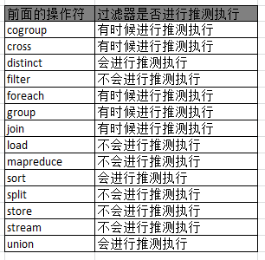
调优
编写优质的脚本-尽早使用过滤器

Slide 101
调优
编写优质的脚本-尽早地并经常地进行映射
下面的例子中并没有用到字段itemid，因此并不需要加载它
txns = load 'purchases' as (date, storeid, amount, itemid);
todays = filter txns by date == '20110513'; -- date not needed after this
bystore = group todays by storeid;
avgperstore = foreach bystore generate group, AVG(todays.amount);
在这种情况下，需要用户自己在foreach语句中今早地移除不需要的字段。

Slide 102
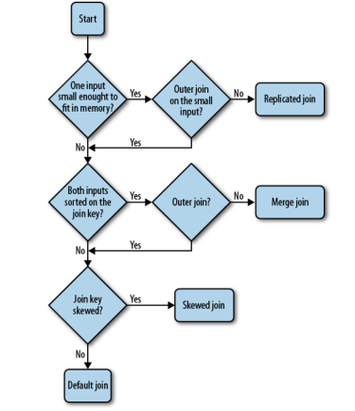
调优
编写优质的脚本-正确并合理使用join

Slide 103
调优
编写优质的脚本-适当的情况下使用multiquery
每当做一些可以通过multiquery进行组装的操作的时候，例如分组和过滤，这些应当写在一个Pig Latin脚本中，这样Pig可以把它们组合在一起。虽然增加额外的操作会增加整体处理时间，但是还是会比单独执行这些任务要快。

Slide 104
调优
编写优质的UDF
Pig有一些特性试图使聚合函数执行得更快
Algebraic接口允许UDF使用Hadoop的组合器
Accumulator接口允许Pig将一组记录分拆成多组然后依次将分拆后的组传递给UDF。

Slide 105
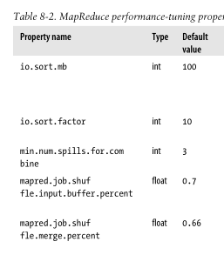
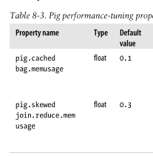
调优
调整Pig和Hadoop

Slide 106
调优
对计算中间结果进行压缩
默认情况下压缩是关闭的
开启MR压缩
将压缩属性设为true
mapred.compress.map.output→t
同时设置压缩格式，如
mapred.map.output.compression.codec
org.apache.hadoop.io.compress.GzipCodec
或
org.apache.hadoop.io.compress.lzo.LzopCodec
开启pig压缩（如果脚本中含有join影响更明显）
pig.tmpfilecompression--true
pig.tmpfilecompression.codec--为gzip或lzo

Slide 107
调优
数据层优化
从0.8版本开始，当输入的是文件而且它们比一个HDFS数据块的一半还小的时候，Pig在使用这个文件作为数据时，会自动将较小的部分合并在一起。
如果想关闭该功能，可以通过命令行参数
-Dpig.noSplitCombination=true
或者在参数文件pig.properties中设置

